Slide 1

DECEMBER 2030
Social Media Report
Quarterly Performance and Assessment
SOCIAL MEDIA | QUARTERLY REPORT
DECEMBER 2030

Slide 2






2
Insights and highlights for:
Facebook
Instagram
X (formerly Twitter)
LinkedIn
YouTube
Report Outline
SOCIAL MEDIA | QUARTERLY REPORT
DECEMBER 2030

Slide 3

3
Performance Overview
Highs and Lows
Presentations are communication tools that can
be used as demonstrations, lectures, speeches, reports, and more. It is mostly presented
before an audience.
It serves a variety of purposes, making presentations powerful tools for convincing and teaching. To create a stunning presentation, it's best to simplify your thoughts.
Start with an outline of topics and identify highlights, which can be applied to whatever subject you plan on discussing.
SOCIAL MEDIA | QUARTERLY REPORT
DECEMBER 2030

Slide 4



4
Facebook Insights
Likes
Engagements
Mentions
Presentations are communication tools that can be used as demonstrations, lectures, speeches, reports, and more. It is mostly presented before an audience.
Presentations are communication tools that can be used as demonstrations, lectures, speeches, reports, and more. It is mostly presented before an audience.
Presentations are communication tools that can be used as demonstrations, lectures, speeches, reports, and more. It is mostly presented before an audience.
SOCIAL MEDIA | QUARTERLY REPORT
DECEMBER 2030

Slide 5
5
Previous Quarter
Current Quarter
Presentations are communication tools that can be used as demonstrations, lectures, speeches, reports, and more.
Presentations are communication tools that can be used as demonstrations, lectures, speeches, reports, and more.
Presentations are communication tools that can be used as demonstrations, lectures, speeches, reports, and more.
Presentations are communication tools that can be used as demonstrations, lectures, speeches, reports, and more.
Presentations are communication tools that can be used as demonstrations, lectures, speeches, reports, and more.
Presentations are communication tools that can be used as demonstrations, lectures, speeches, reports, and more.
SOCIAL MEDIA | QUARTERLY REPORT
DECEMBER 2030

Slide 6
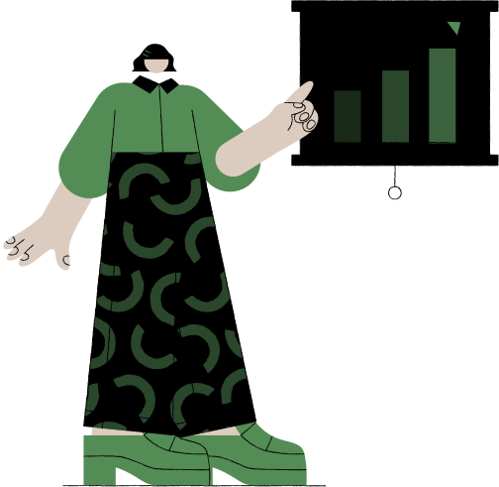
6
Key Campaign
112%
Overall increase in engagement
Presentations are communication tools that can be used as demonstrations, lectures, speeches, reports, and more. It is mostly presented before an audience.
SOCIAL MEDIA | QUARTERLY REPORT
DECEMBER 2030

Slide 7

7
Twitter Highlights
Most Views
Most Shares
Most Comments
Informational Tweet
Campaign Tweet
Engagement Tweet
Presentations are communication tools that can be used as demonstrations, lectures, speeches, reports, and more. It is mostly presented before an audience.
Presentations are communication tools that can be used as demonstrations, lectures, speeches, reports, and more. It is mostly presented before an audience.
Presentations are communication tools that can be used as demonstrations, lectures, speeches, reports, and more. It is mostly presented before an audience.
SOCIAL MEDIA | QUARTERLY REPORT
DECEMBER 2030

Slide 8
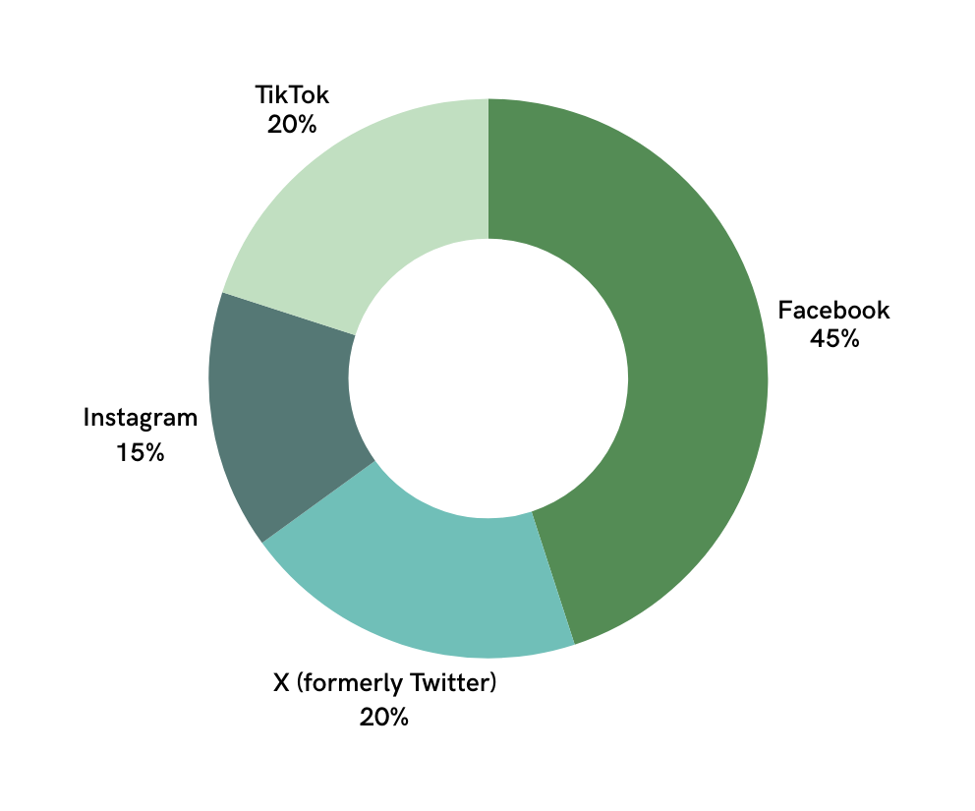
8
Audience by Segment
Distribution per
social media channel
Paragraph that explains the data sources, outlines what the chart illustrates, and provides guidance on interpreting the visualizations to inform decision-making.
SOCIAL MEDIA | QUARTERLY REPORT
DECEMBER 2030

Slide 9
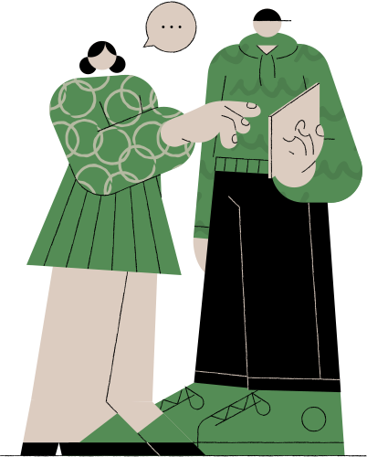
9
Presentations are communication tools that can be used as demonstrations, lectures, speeches, reports, and more.
It is mostly presented before
an audience.
SOCIAL MEDIA | QUARTERLY REPORT
DECEMBER 2030

Slide 10

10
New Channel: LinkedIn
SOCIAL MEDIA | QUARTERLY REPORT
DECEMBER 2030

Slide 11
11
Did we meet our goals?
Brand Awareness
HR Recruitment
Brand
Engagement
Professional
Network
Presentations are communication tools that can be used as demonstrations, lectures, speeches, reports, and more. It is mostly presented before an audience.
Presentations are communication tools that can be used as demonstrations, lectures, speeches, reports, and more. It is mostly presented before an audience.
Presentations are communication tools that can be used as demonstrations, lectures, speeches, reports, and more. It is mostly presented before an audience.
Presentations are communication tools that can be used as demonstrations, lectures, speeches, reports, and more. It is mostly presented before an audience.
SOCIAL MEDIA | QUARTERLY REPORT
DECEMBER 2030

Slide 12
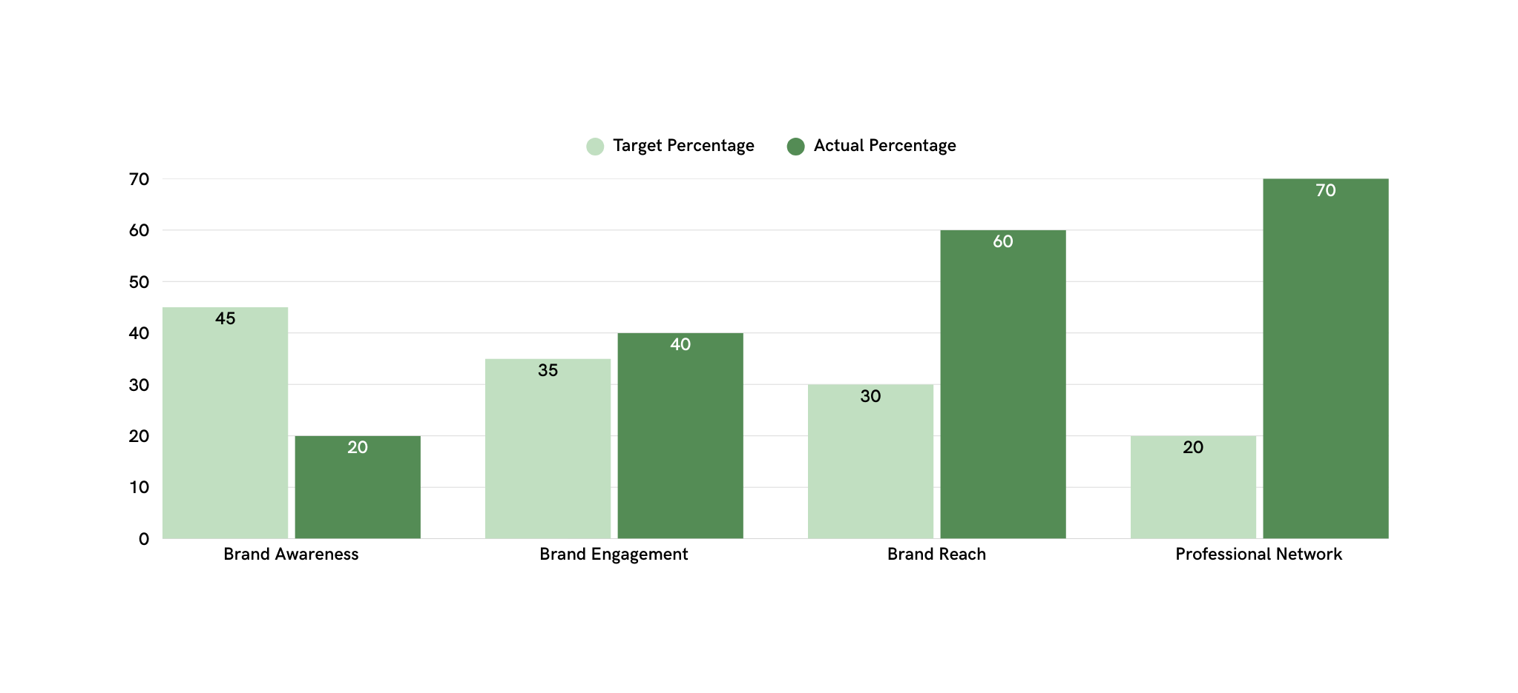
Goal Percentage Comparison
12
Subheading that highlights the focus of the charts and sets context for the data presented.
SOCIAL MEDIA | QUARTERLY REPORT
DECEMBER 2030

Slide 13
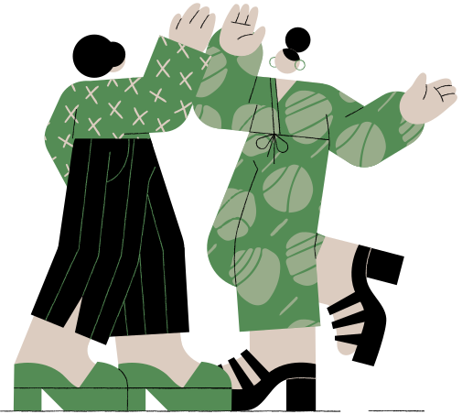
13
Overall
Performance
What we did right
Audience Growth
Content Plan
New Campaigns
New Channels
Interaction & Feedback
SOCIAL MEDIA | QUARTERLY REPORT
DECEMBER 2030

Slide 14



14
Next Steps
Maximize Platforms
Presentations are communication tools that can be used as demonstrations, lectures, speeches, reports, and more. It is mostly presented before an audience.
Incentivize Engagement
Presentations are communication tools that can be used as demonstrations, lectures, speeches, reports, and more. It is mostly presented before an audience.
Encourage Feedback
Presentations are communication tools that can be used as demonstrations, lectures, speeches, reports, and more. It is mostly presented before an audience.
SOCIAL MEDIA | QUARTERLY REPORT
DECEMBER 2030

Slide 15
15
Optimize
Presentations are communication tools that can be used as demonstrations, lectures, speeches, reports, and more.
Launch
Presentations are communication tools that can be used as demonstrations, lectures, speeches, reports, and more.
Next Quarter Timeline
Run
Presentations are communication tools that can be used as demonstrations, lectures, speeches, reports, and more.
Strategic Plan
Refine
Presentations are communication tools that can be used as demonstrations, lectures, speeches, reports, and more.
Analyze
Presentations are communication tools that can be used as demonstrations, lectures, speeches, reports, and more.
SOCIAL MEDIA | QUARTERLY REPORT

Slide 16



16
Meet the Social Media Team
Report Authors
Violla Bertson
Nestore Intigua
Olga Tronilsky
Lead analyst
Campaign strategist
Creative lead
SOCIAL MEDIA | QUARTERLY REPORT
DECEMBER 2030

Slide 17
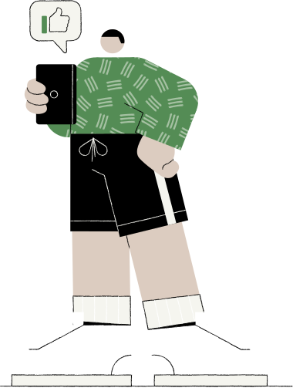
17
Phone Number
Contact us
123-456-7890
Email Address
For questions or comments
hello@reallygreatsite.com
Website
www.reallygreatsite.com
SOCIAL MEDIA | QUARTERLY REPORT
DECEMBER 2030

Slide 18
18
“Success begins in the mind; envision it, and your path will follow.”
— Laurence Yáo
SOCIAL MEDIA | QUARTERLY REPORT
DECEMBER 2030

Slide 19

























19
Resource Page
Use these in your presentation.
Delete or hide this page before presenting.

Slide 20
20
B for blur | C for confetti
D for a drumroll | M for mic drop
O for bubbles | Q for quiet
U for unveil | Any number from 0-9 for a timer
Resource Page
Find the magic in presenting. Select these keys while in Present mode.
Delete or hide this page before presenting.

Slide 21
21
Go to Uploads, then Record Yourself.
All recordings will be saved on Canva in your Uploads folder.
Edit your recording. Feel free to adjust the background, volume, and duration.
Need multiple presenters? Select Share then update Collaboration link to Can edit.
Share editable link. Assign team members to record their sections.
You can also mix live presentation and recorded videos to make your session more engaging.
Resource Page
Want more flexibility as a presenter? Record your presentation to engage in a way that works for you — and let your audience watch in a way that works for them.
Delete or hide this page before sharing.

